Slide 1
WP1
Path Enumeration

Slide 2
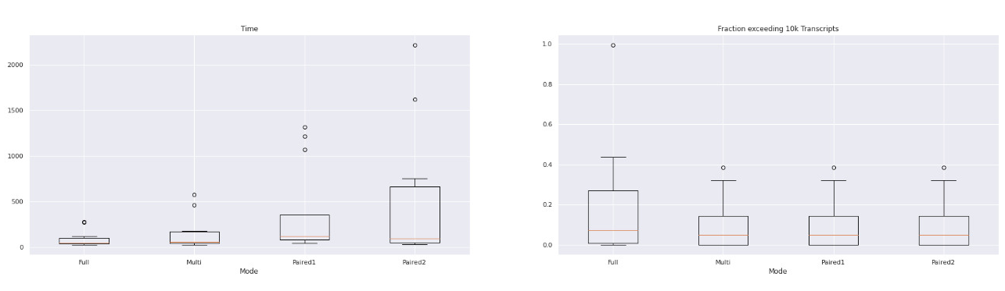
Runtime and Fraction exceeding 10k Transcripts

Slide 3
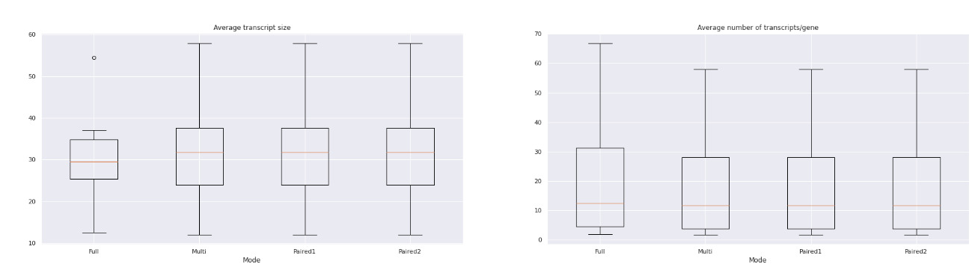
Transcript size and Transcripts per gene

Slide 4
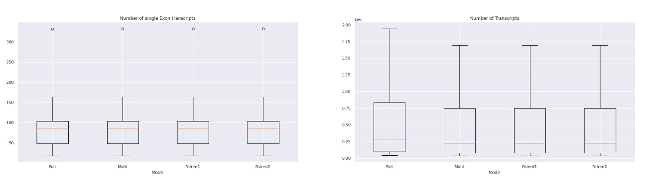
Single Exon Transcripts and Number of Transcripts

Slide 5
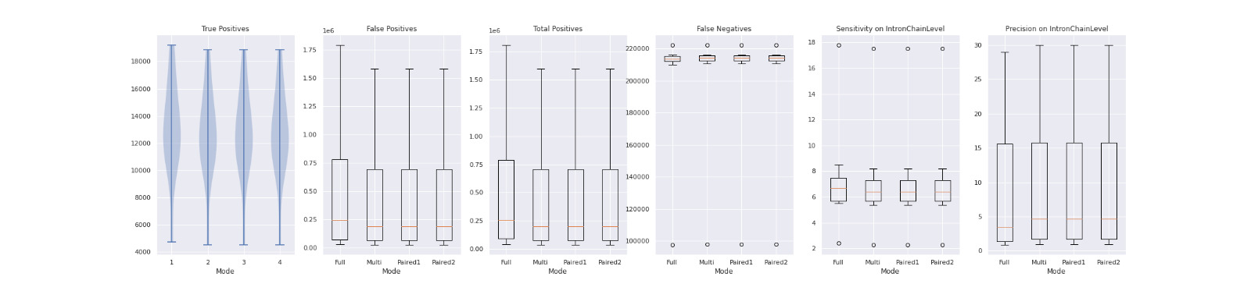
False / True / Total Positives, False Negatives

Slide 6
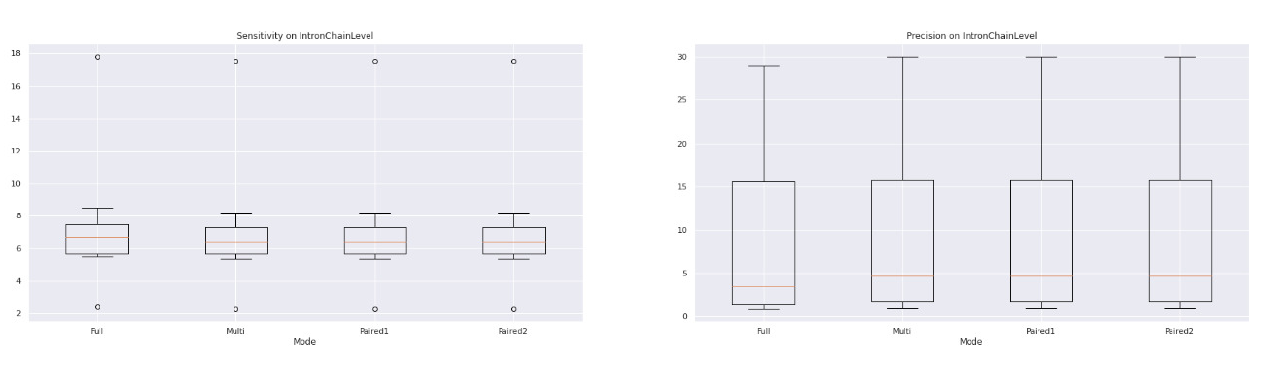
Sensitivity and Precision

Slide 7
Datasets:
Human_simulated
Human_leukemia
Human Diverse:
SRR307903
SRR307911
SRR315323
SRR315334
SRR387661
SRR534291
SRR534307
SRR534319
SRR545695

Slide 8
WP2
Optimization with Gurobi

Slide 9
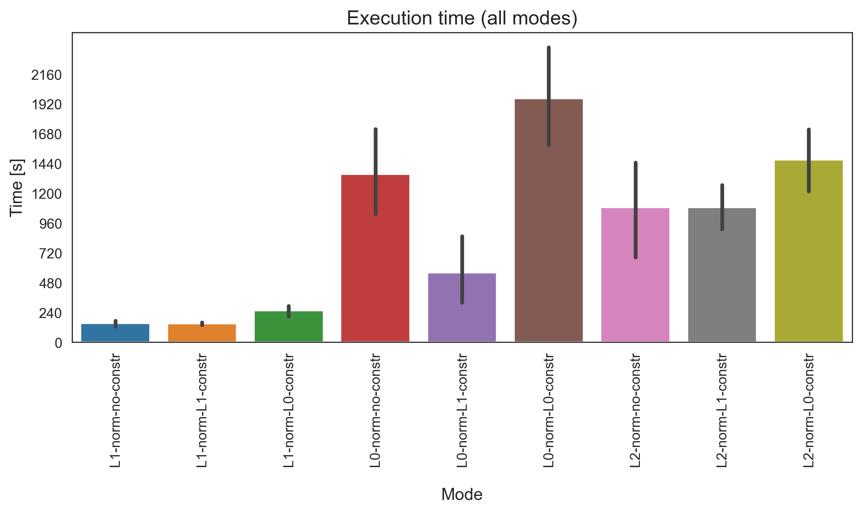
Execution time for one graph file
Full Path Enumeration
Datasets
Human geuvadis simulated
Human leukemia real
Human diverse
SRR307903 (Fibroblasts)
SRR307911 (Embryonic stem cells)
L1 norm
L0 norm
L2 norm

Slide 10
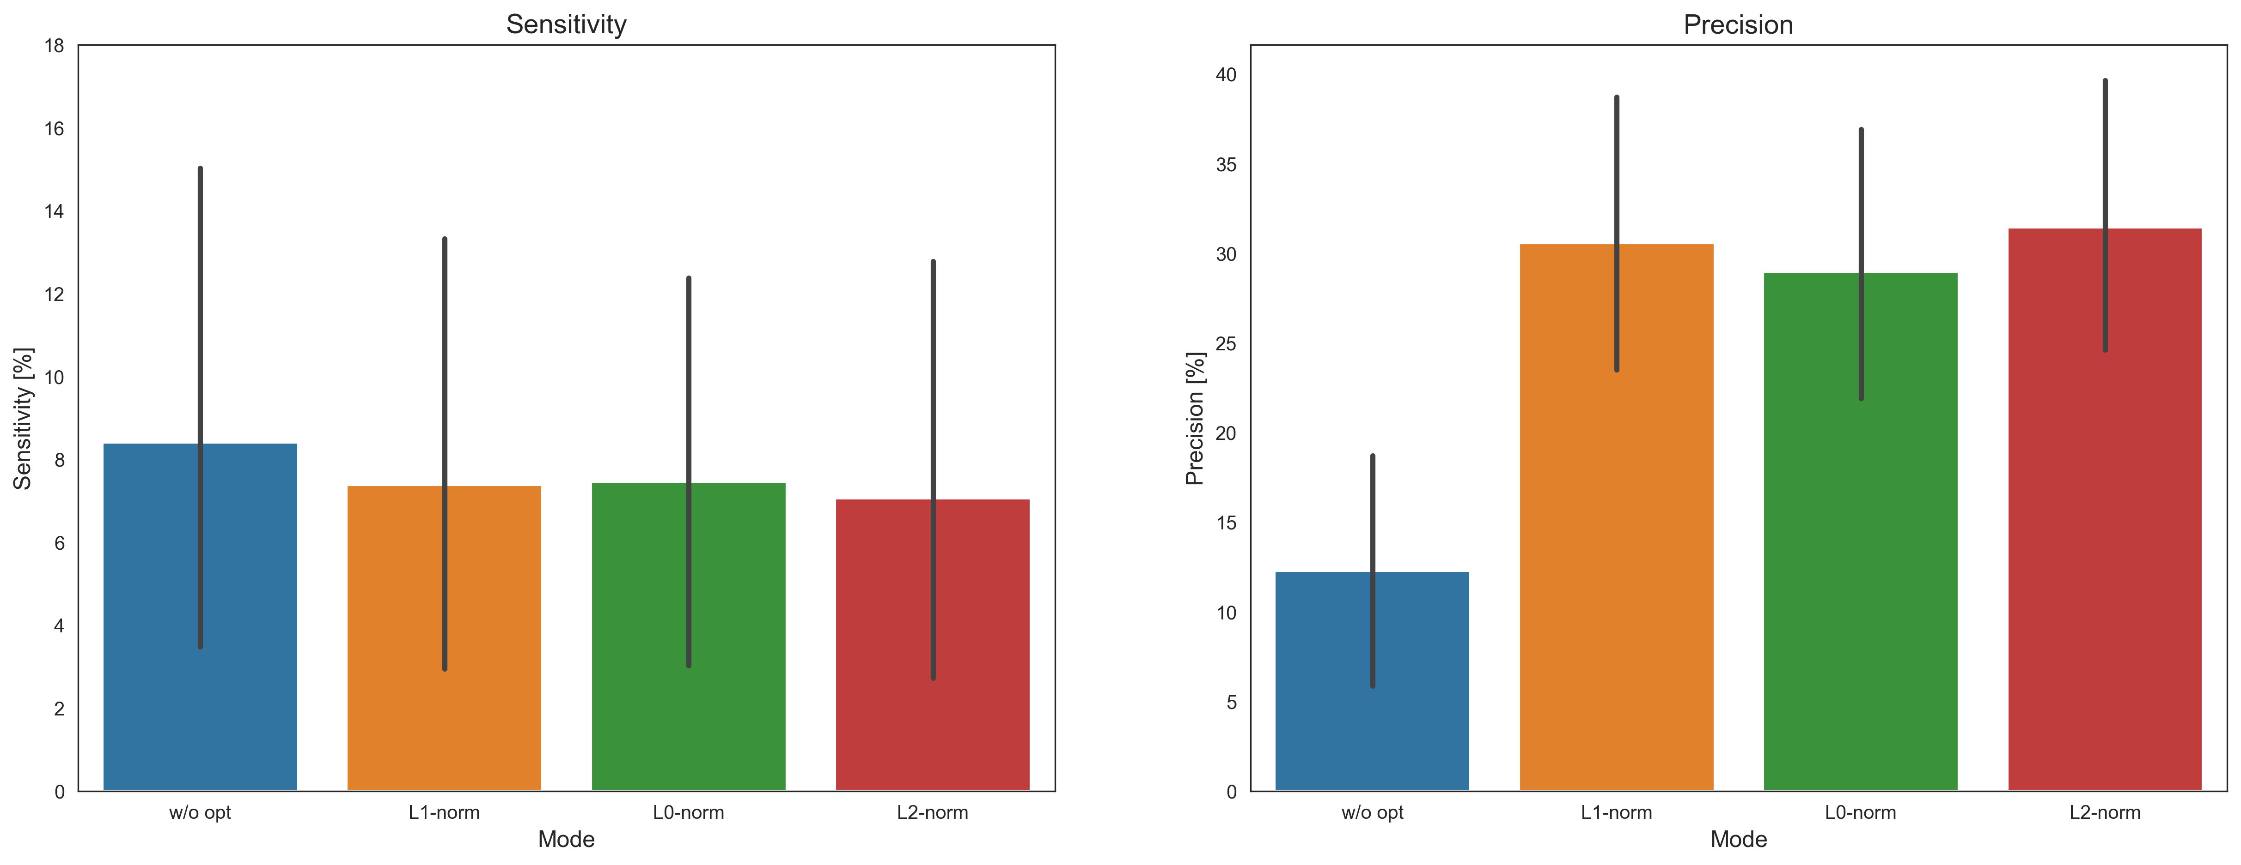
Sensitivity and Precision
Without sparsity constraints

Slide 11
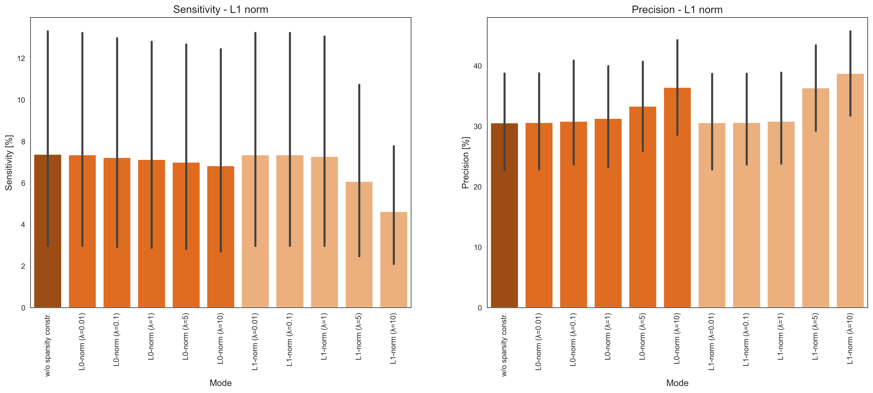
Sensitivity and Precision
With sparsity constraints

Slide 12
WP3
Flow-based Optimization

Slide 13
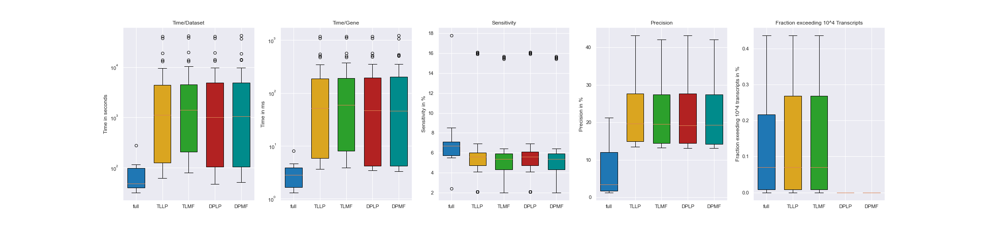
Time Analysis for flow-based Optimization
11 datasets:
Human_simulated
Human_leukemia
Human Diverse
SRR307903
SRR307911
SRR315323
SRR315334
SRR387661
SRR534291
SRR534307
SRR534319
SRR545695
6 cost-functions per mode
3 linear
3 quadratic

Slide 14
Precision and Sensitivity for flow-based Optimization

Slide 15
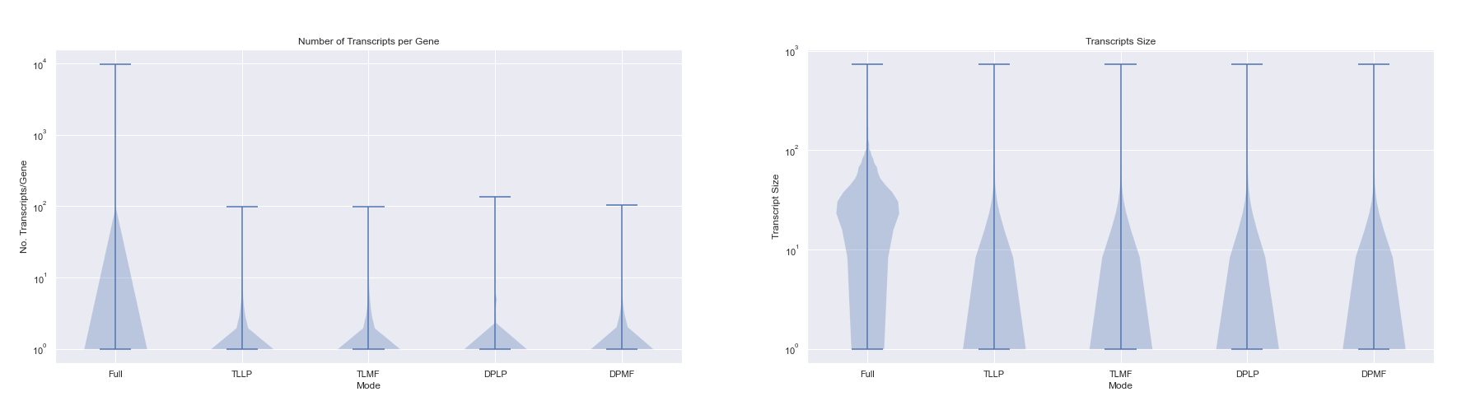
Number of Transcripts and Transcript Size for flow-based Optimization

Slide 16
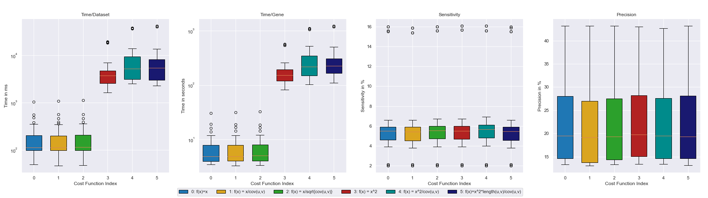
Cost-function dependent results for flow-based Optimization

Slide 17
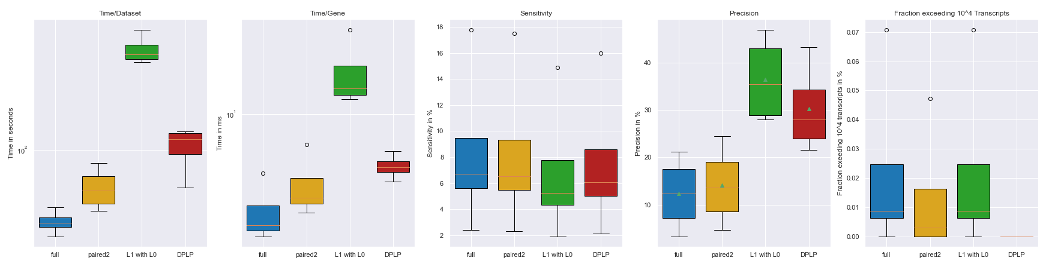
Overall results

Slide 18
Vielen Dank.

Slide 19
Anhang

Slide 20
WP2 - Anhang

Slide 21
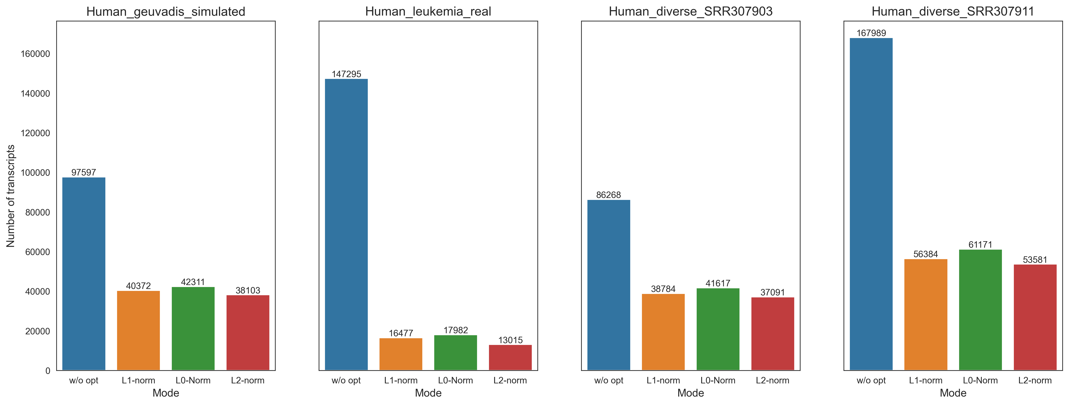
Total number of transcripts
Without sparsity constraints

Slide 22
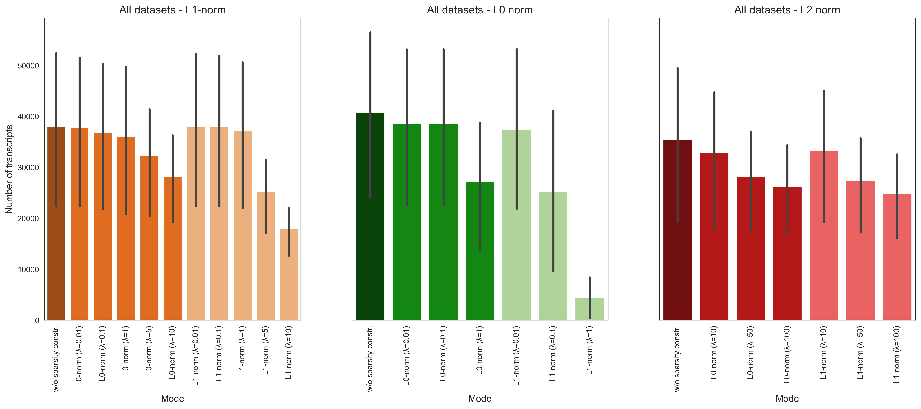
Total number of transcripts
With sparsity constraints

Slide 23
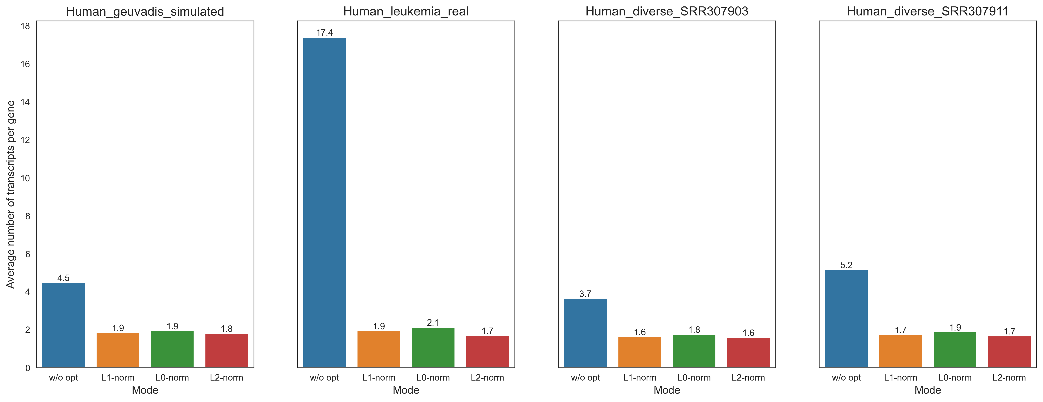
Number of transcripts per gene
Without sparsity constraints

Slide 24
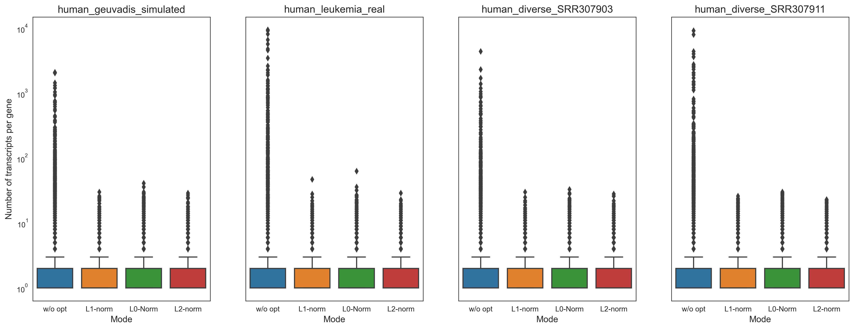
Number of transcripts per gene
Without sparsity constraints

Slide 25
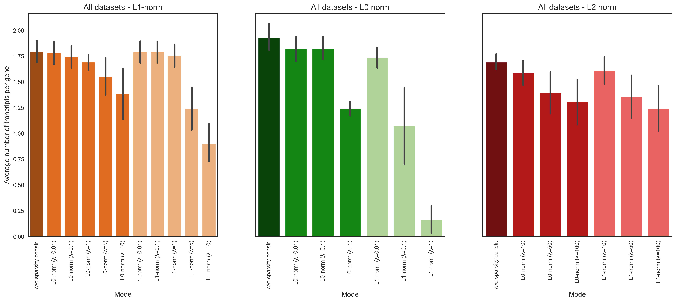
Number of transcripts per gene
With sparsity constraints

Slide 26
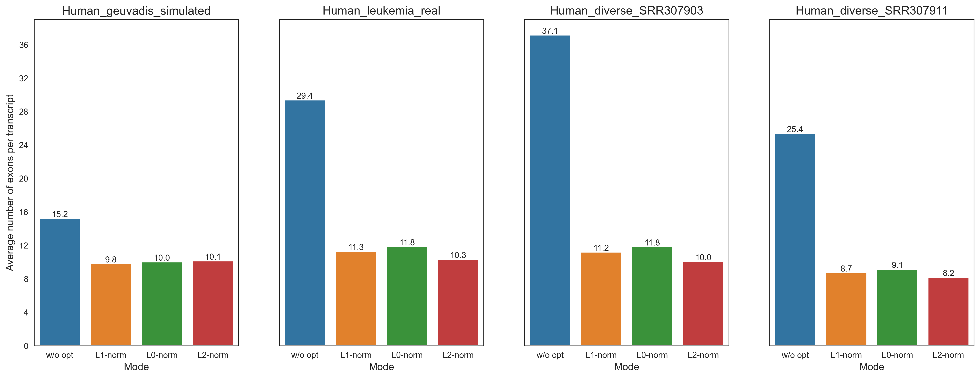
Number of exons per transcript
Without sparsity constraints

Slide 27
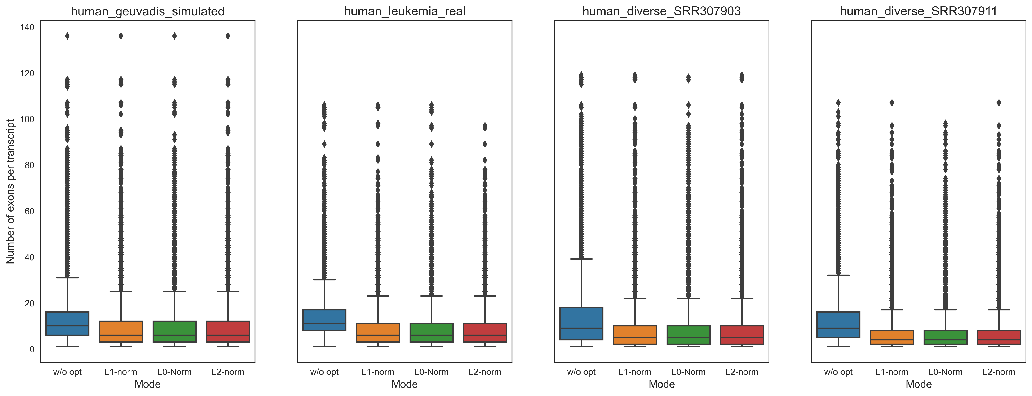
Number of exons per transcript
Without sparsity constraints

Slide 28
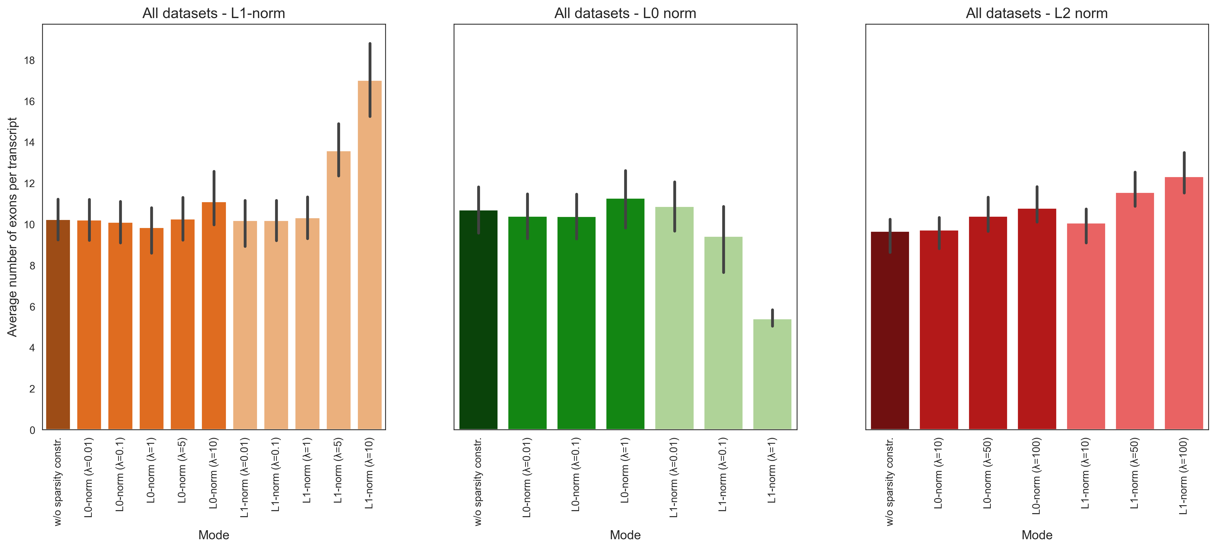
Number of exons per transcript
With sparsity constraints

Slide 29
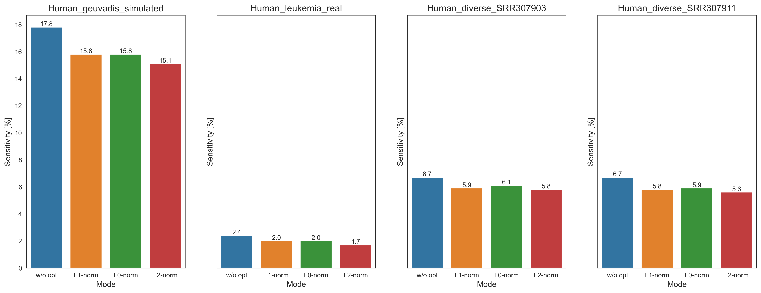

Sensitivity
Without sparsity constraints
$$Sensitivity=\frac{TP}{TP+FN}$$

Slide 30
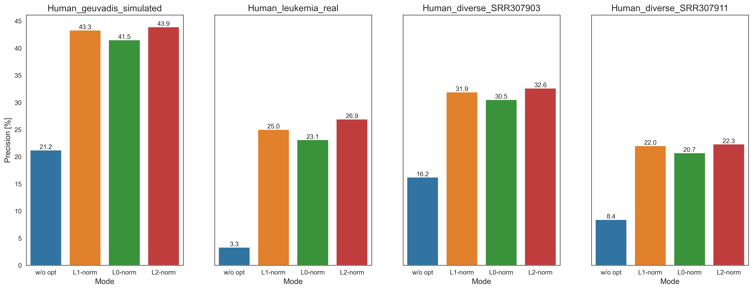
Precision
Without sparsity constraints
$$Precision=\frac{TP}{P}$$

Slide 31
Sensitivity and Precision
L1 norm
With sparsity constraints

Slide 32
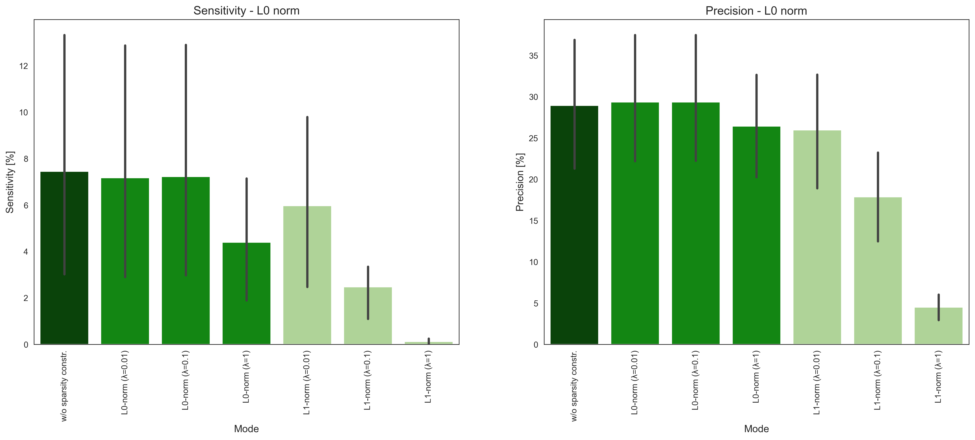
Sensitivity and Precision
L0 norm
With sparsity constraints

Slide 33
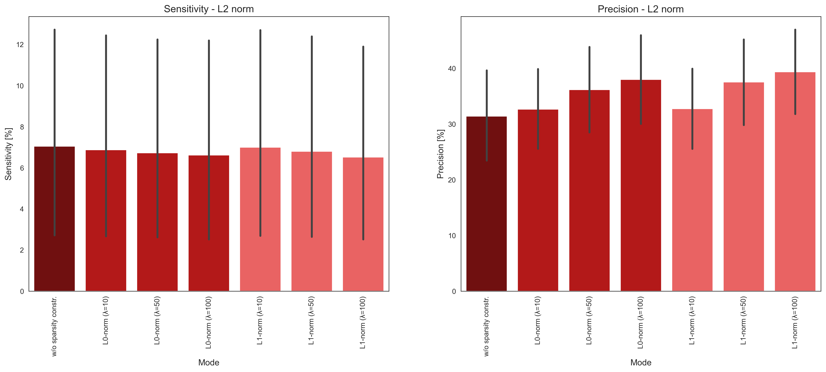
Sensitivity and Precision
L2 norm
With sparsity constraints

Slide 34
Anhang WP3

Slide 35
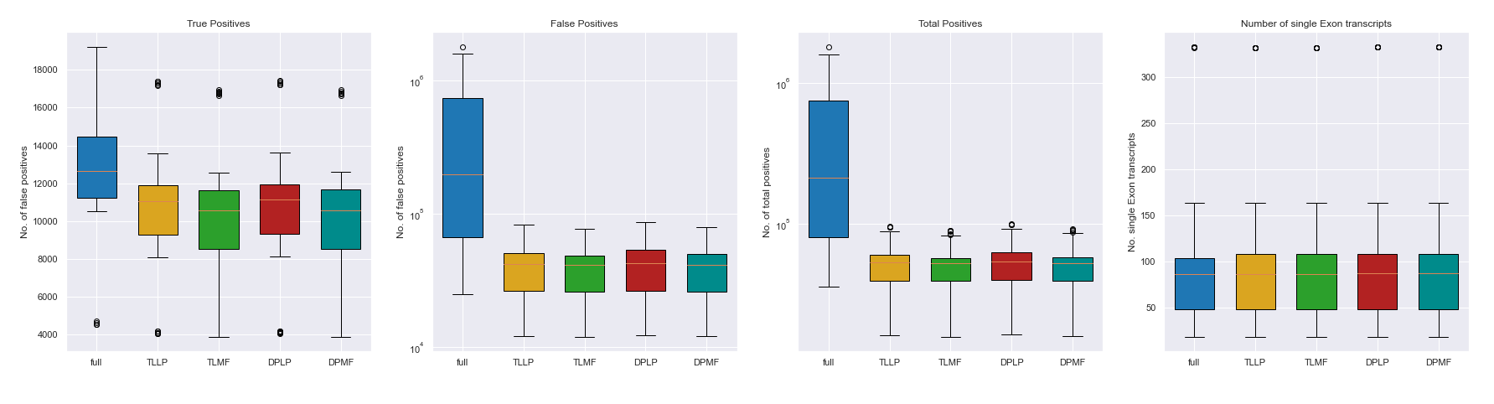
Further Analysis for flow-based Optimization

Slide 36
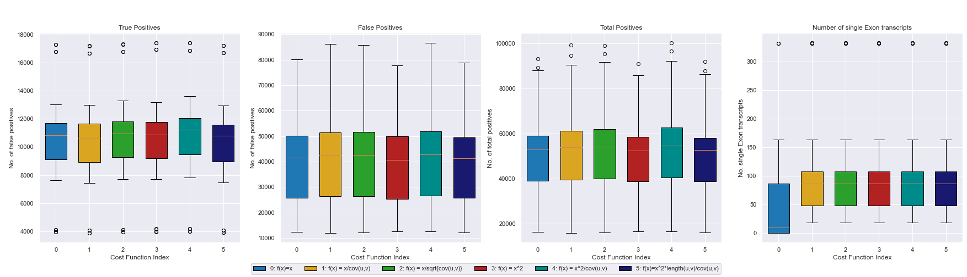
Further Analysis for flow-based Optimization

Slide 37
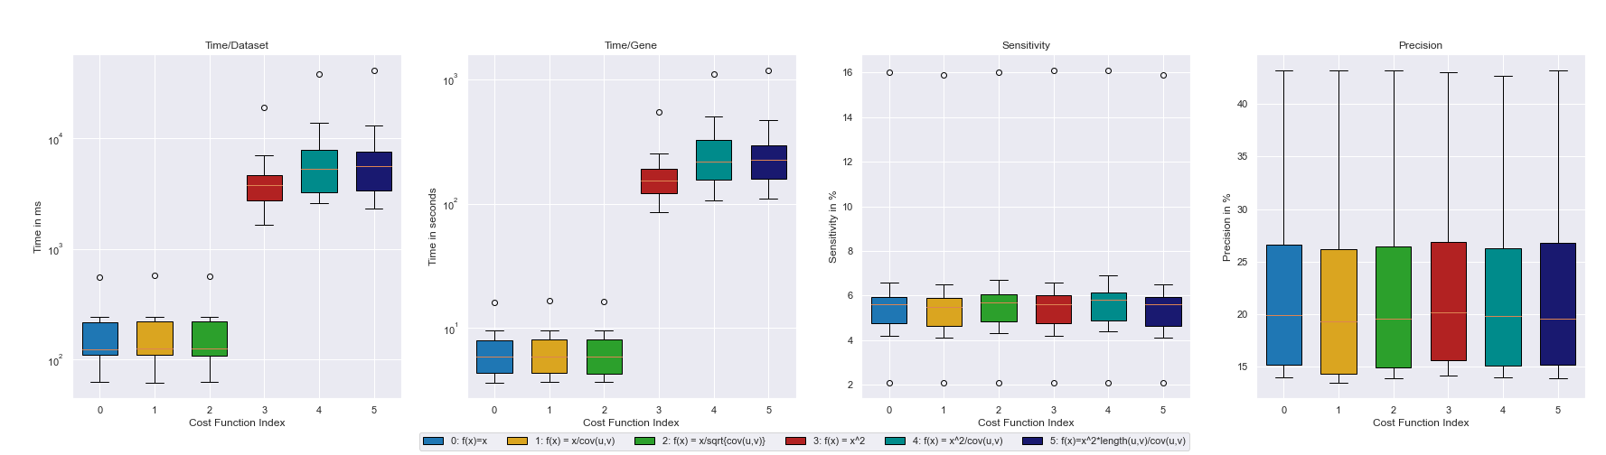
Analysis for flow-based Optimization (TLLP)

Slide 38
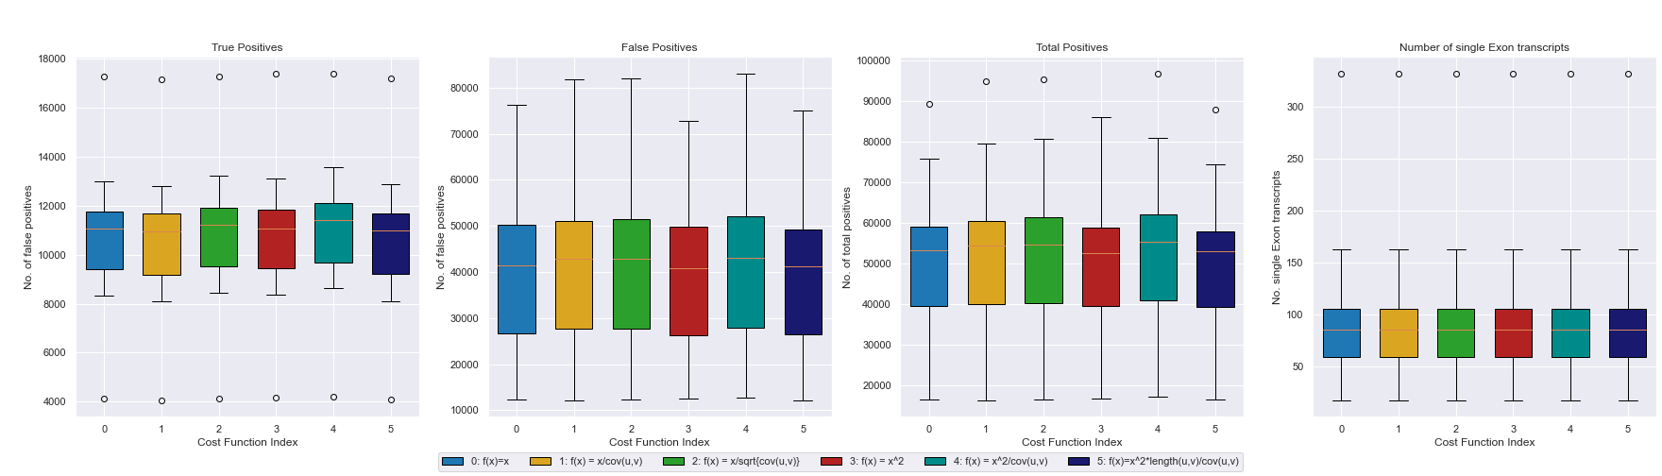
Analysis for flow-based Optimization (TLLP)

Slide 39
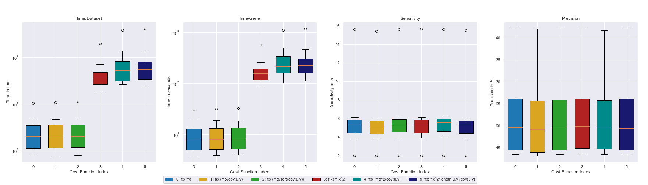
Analysis for flow-based Optimization (TLMF)

Slide 40
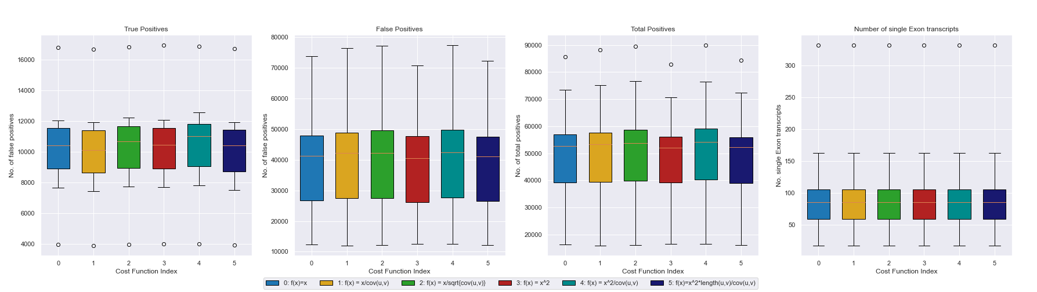
Analysis for flow-based Optimization (TLMF)

Slide 41
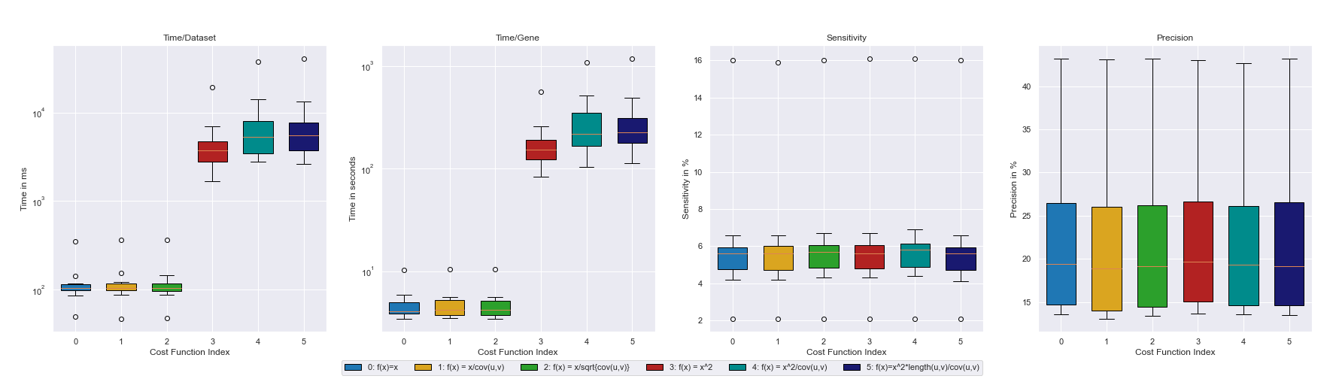
Analysis for flow-based Optimization (DPLP)

Slide 42
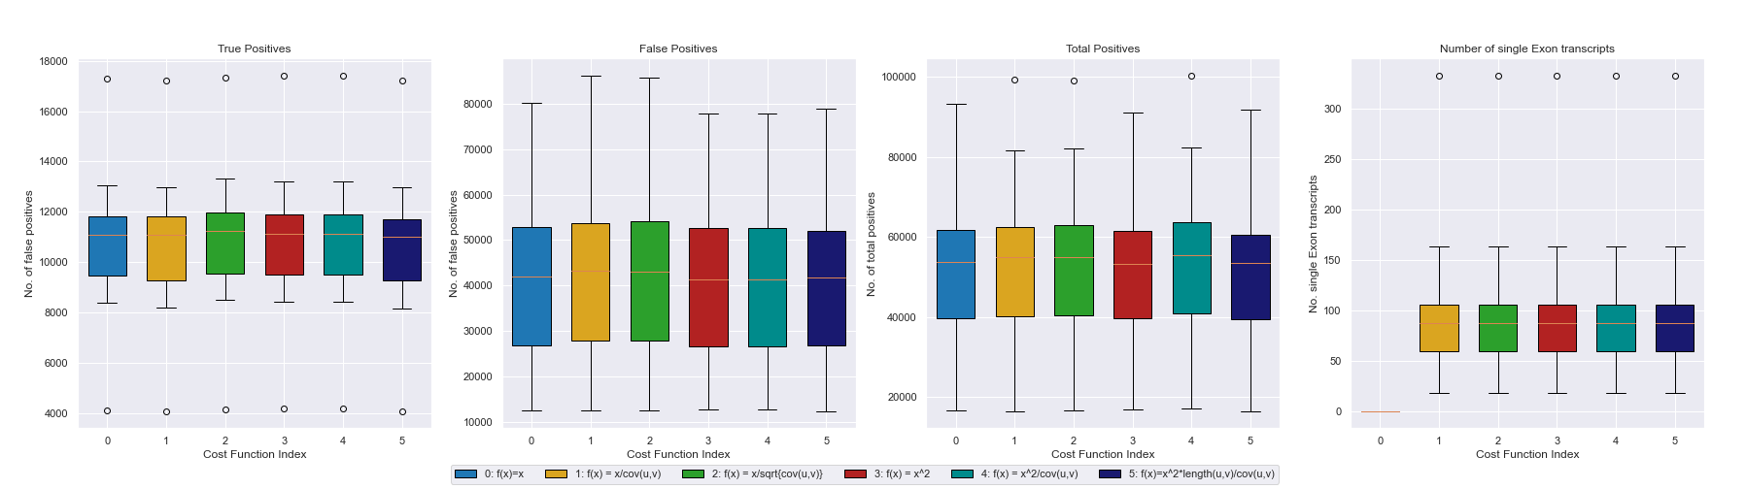
Analysis for flow-based Optimization (DPLP)

Slide 43
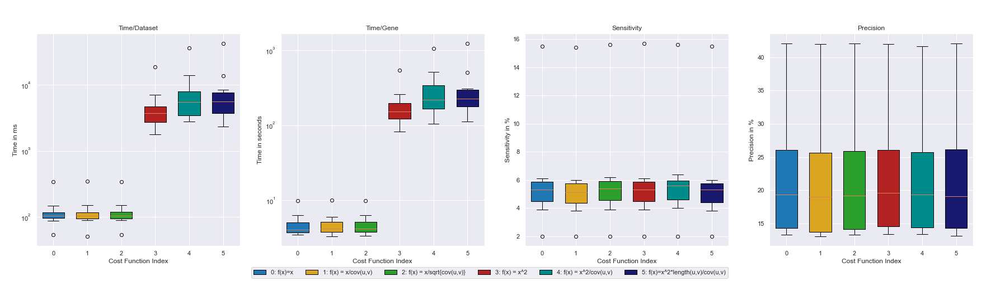
Analysis for flow-based Optimization (DPMF)

Slide 44
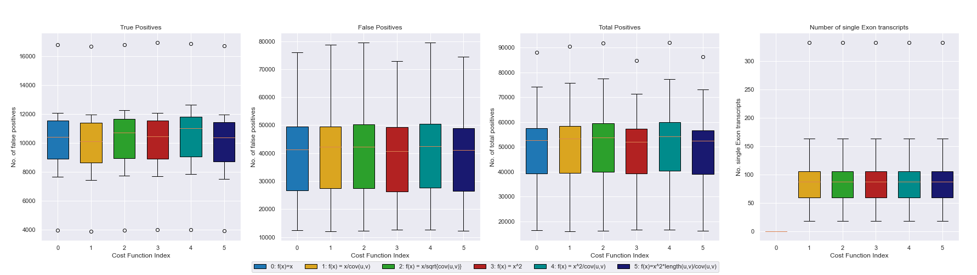
Analysis for flow-based Optimization (DPMF)

